Slide 1

Fetching and Caching Data

Slide 2
Objectives
When to fetch and store data in React.
How to use window.fetch.
What promises are.
How async/await works.
How to simplify network requests with Axios.

Slide 3
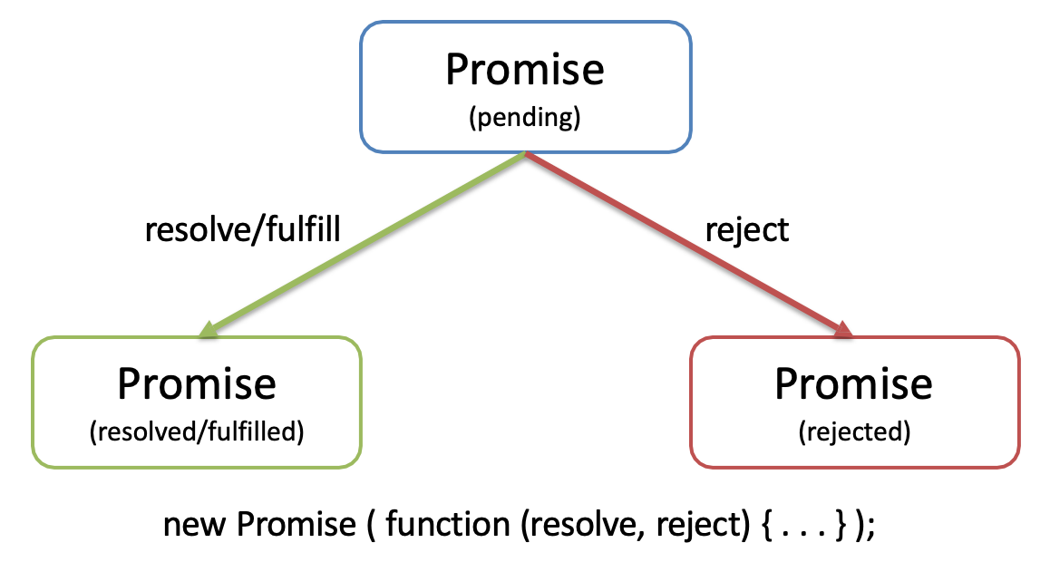
Promise and Async/Await
Promise is a mechanism that supports asynchronous computation
It lets you write asynchronous code in a synchronous way, but instead of returning the final value, it returns a “promise” to return the final value at some point.
Promises can be in one of three states:
Pending: This is the initial state of a promise.
Fulfilled: The operation was completed successfully.
Rejected: The operation failed.

Slide 4
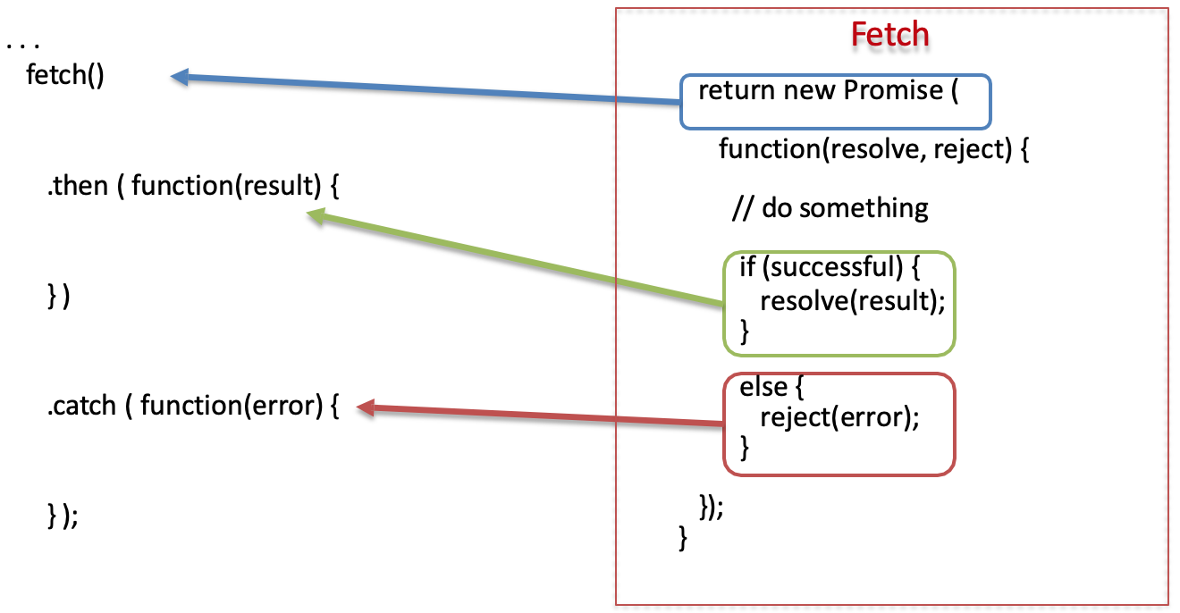
Promise Example

Slide 5
Why Promises?
Solves the callback hell (heavily nested callback code) problem
Promises can be chained
Can immediately return:
Promise.resolve(result)
Promise.reject(error)
const fetchData = () => {
return new Promise((resolve, reject) => {
// Simulate an asynchronous request
setTimeout(() => {
const data = "Data has been loaded";
const error = null;
// Check the success or failure condition
if (data) {
resolve(data); // Resolve Promise with data
} else {
reject(error); // Promise rejected with error
}
}, 2000); // Simulate loading time
});
};
Notes:
Sử dụng Promise giúp giải quyết vấn đề "callback hell" (mã callback lồng sâu) như sau:
Promises có thể được gắn chuỗi (chained) với nhau. Bạn có thể truyền kết quả của một promise cho promise tiếp theo.
Promise có thể trả về ngay:
Promise.resolve(result) để trả về kết quả thành công.
Promise.reject(error) để trả về lỗi.
Chained là việc gắn liền, liên kết nhiều promise với nhau.
Chẳng hạn như ví dụ trên, ta có:
func1() trả về promise.
Sau đó ta dùng .then() để thực thi hàm func2(), hàm này cũng trả về một promise.
Tiếp tục ta dùng .then() nữa để thực thi func3(), ...

Slide 6
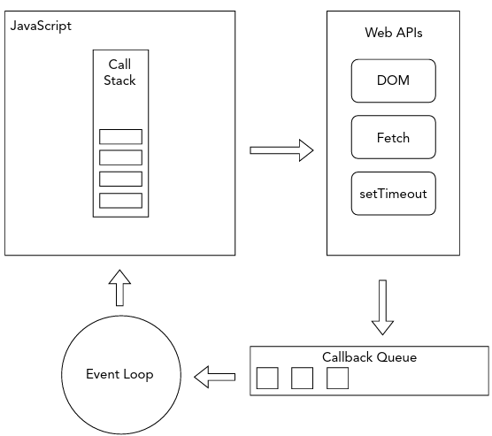
How asynchronous tasks are handled

Slide 7
Convert from Function to Promise
function userCheck(username, password, callback){
db.verifyUser(username, password, (error, userInfo) => {
if (error) {
callback(error)
}else{
db.getRoles(username, (error, roles) => {
if (error){
callback(error)
}else {
db.logAccess(username, (error) => {
if (error){
callback(error);
}else{
callback(null, userInfo, roles);
}
})
}
})
}
})
};
userCheck(username, password)
.then(({ userInfo, roles }) => {
// Process when the result is successful
console.log("User Info:", userInfo);
console.log("Roles:", roles);
})
.catch((error) => {
// Handle when an error occurs
console.error("Error:", error);
});

Slide 8
What Async/Await?
Async/await is a JavaScript syntax that makes handling asynchronous functions easier to read and write. It uses the async and await keywords to create synchronous processing from asynchronous functions.
When a function is marked as async, it returns a Promise and allows the use of the await keyword within it to wait until a Promise is resolved or rejected.

Slide 9


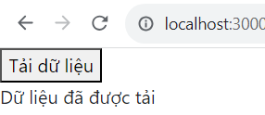
Async/Await Example
const ExampleComponent = () => {
const [loading, setLoading] = useState(false);
const [data, setData] = useState(null);
const [error, setError] = useState(null);
const fetchDataHandler = async () => {
setLoading(true);
try {
const response = await fetchData();
setData(response);
setError(null);
} catch (error) {
setData(null);
setError(error);
} finally {
setLoading(false);
}
};
return (
<div>
<button onClick={fetchDataHandler} disabled={loading}>
{loading ? "Đang tải..." : "Tải dữ liệu"}
</button>
{data && <div>{data}</div>}
{error && <div>Error: {error}</div>}
</div>
);
};
export default ExampleComponent;
import { useState } from "react";
const fetchData = () => {
return new Promise((resolve, reject) => {
// Simulate an asynchronous request
setTimeout(() => {
const data = "Data has been loaded";
const error = null;
// Check the success or failure condition
if (data) {
resolve(data); // Resolve Promise with data
} else {
reject(error); // Promise rejected with error
}
}, 2000); // Simulate loading time
});
};

Slide 10
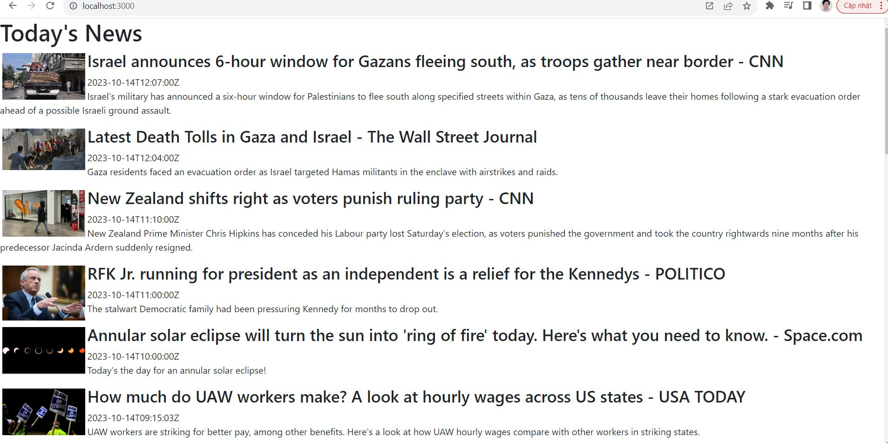
Where to run async code
import { useEffect, useState } from "react";
const NewsFeed = () => {
const [news, setNews] = useState([]);
useEffect(() => {
fetch(
"https://newsapi.org/v2/top-headlines?country=us&apiKey=[YourKey]"
)
.then((response) => response.json())
.then((data) => {
setNews(data.articles);
})
.catch((error) => console.error(error));
}, []);
const todaysNews = news.map((article) => {
return <p>{article.title}</p>;
});
return (
<>
<h1>Today's News</h1>
{todaysNews}
</>
);
};
export default NewsFeed;
The useEffect hook can be used for fetching a component’s initial data as well as in response to the component receiving new data
Need a free API key from https://newsapi.org/
https://newsapi.org/docs/endpoints/top-headlines

Slide 11
Ways to Fetch
Representational State Transfer, or REST, is an architectural style for application programming interfaces (APIs). RESTful APIs use HTTP requests to get, add, update, and delete data using unique URLs.
Using API:
To fetch data, use the HTTP GET method.
To add data, use the HTTP POST method.
To update data, use the HTTP PUT method.
To delete data, use the HTTP DELETE method.

Slide 12
Getting data with Fetch
import { useState } from "react";
function Restful(){
const [repos,setRepos] = useState([]);
const [status,setStatus] = useState();
const getRepos = function(){
fetch('https://api.github.com/users/facebook/repos')
.then(response => response.json())
.then(data => {
setRepos(data);})
.then(setStatus("fetched"))
.catch(error => console.error(error))
}
const logRepos = function(){
console.log(repos);
}
return(
<>
<button onClick={getRepos}>{status?"Fetched":"Fetch Repos"}</button>
<button onClick={logRepos}>Log Repos</button>
</>
)
}
export default Restful;
window.fetch is a method built into all modern browsers that allows you to perform HTTP requests from JavaScript without loading a separate library.
Example of using the Fetch API to fetch data and log it to the console in a React component.

Slide 13
Getting data with AXIOS
import axios from "axios";
import { useState } from "react";
function Restful(){
const [repos,setRepos] = useState([]);
const [status,setStatus] = useState();
const getRepos = function(){
axios({
method:'get',
url:'https://api.github.com/users/facebook/repos'
}).then(resp => {setRepos(resp.data);})
.then(setStatus("fetched"))
.catch(error => console.error(error))
}
const logRepos = function(){
console.log(repos);
}
return(
<>
<button onClick={getRepos}>{status?"Fetched":"Fetch Repos"}</button>
<button onClick={logRepos}>Log Repos</button>
</>
)
}
export default Restful;
Axios is a popular AJAX library that you can use instead of the browser’s native Fetch API. Axios has advantages over window.fetch in terms of ease of use and capabilities, but using it does require you to load a separate library.
To install Axios, use the following command:
npm install axios@1.5.1
The convenience methods include:
axios.get
axios.post
axios.delete
axios.put

Slide 14
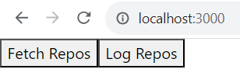
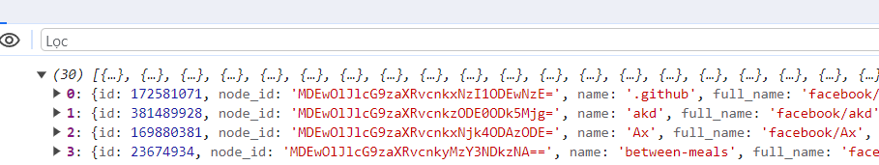
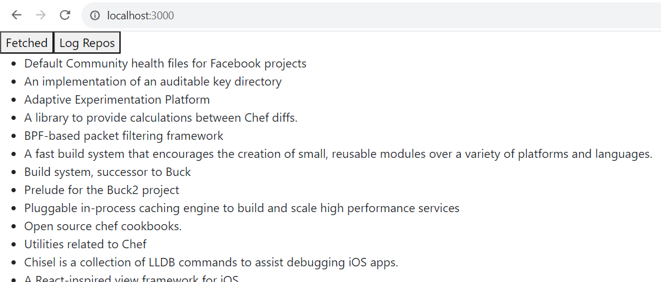
Show result
{repos.length > 0 && (
<ul>
{repos.map((repo) => (
<li key={repo.id}>{repo.description}</li>
))}
</ul>
)}

Slide 15
Get with AXIOS
The GET method is used to query data from a server resource or API.
When sending a GET request, data is requested from the server and returned to the user.
const handleGet = () => {
axios
.get("https://api.example.com/posts")
.then((response) => {
setData(response.data);
})
.catch((error) => {
console.error(error);
});
};

Slide 16
Post with AXIOS
The POST method is used to create a new resource on the server or API.
When sending a POST request, data is sent with the request and is passed to the server to create a new resource.
const handlePost = () => {
axios
.post("https://api.example.com/posts", { title: "New Post", body: "Hello, world!" })
.then((response) => {
setPostResult(response.data);
})
.catch((error) => {
console.error(error);
});
};

Slide 17
Put with AXIOS
The PUT method is used to update a resource that already exists on the server or API.
When sending a PUT request, data is sent with the request and is passed to the server to update the information of the existing resource.
const handlePut = () => {
axios
.put("https://api.example.com/posts/1", { title: "Updated Post", body: "Hello again!" })
.then((response) => {
setPutResult(response.data);
})
.catch((error) => {
console.error(error);
});
};

Slide 18
Delete with AXIOS
The DELETE method is used to delete a resource that already exists on the server or API.
When sending a DELETE request, a request is sent to the server to delete the specified resource.
const handleDelete = () => {
axios
.delete("https://api.example.com/posts/1")
.then((response) => {
setDeleteResult(response.data);
})
.catch((error) => {
console.error(error);
});
};

Slide 19
Full Code
import axios from "axios";
import { useState } from "react";
function Restful() {
const [data, setData] = useState(null);
const [postResult, setPostResult] = useState("");
const [putResult, setPutResult] = useState("");
const [deleteResult, setDeleteResult] = useState("");
//POST
//PUT
//DELETE
return (
<>
<button onClick={handleGet}>Fetch Data</button>
{data && (
<div><h2>Data:</h2>
<ul>
{data.map((item) => (
<li key={item.id}>{item.title}</li>
))}
</ul>
</div>
)}
<button onClick={handlePost}>Create Post</button>
<button onClick={handlePut}>Update Post</button>
<button onClick={handleDelete}>Delete Post</button>
<div>Post Result: {postResult}</div>
<div>Put Result: {putResult}</div>
<div>Delete Result: {deleteResult}</div>
</>
);
}
export default Restful;

Slide 20
Exercise 27: Demo about AXIOS

Slide 21
Summary
Concepts were introduced:
When to fetch and store data in React.
How to use window.fetch.
What promises are.
How async/await works.
How to simplify network requests with Axios.

